Slide 1
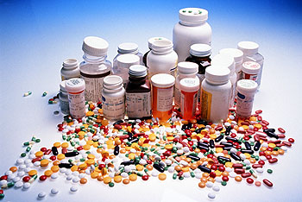
By BI-IN-GO team
Some Drug Consumption Trends

Slide 2
Major contributing Factors -
Age factor
Gender Factor
Gender with Age Factor

Slide 3
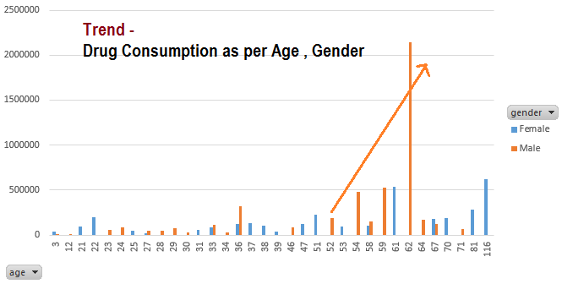
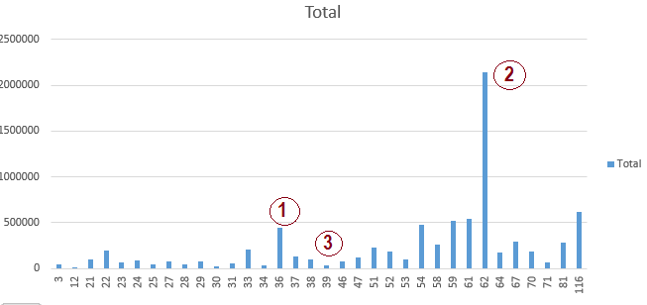
Trend – Total Drug consumption
Combined – Male / Female
Spikes at age 36 and 62
36: Peak careers / struggle?
62: Retirement age?
Visibly lower number at 39
settled down phase?
Male
First Spike at Age 36
peak careers
work life balance challenges?
Significantly Increasing from Age 52 until 62
Challenges relating to medical disorders in
Transition Phase from Work to Retiring?
Female
Visibly consistent with increase towards sun-set age

Slide 4
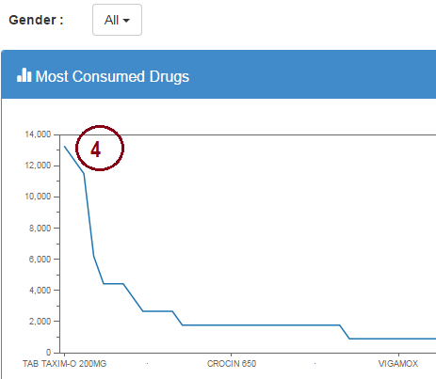
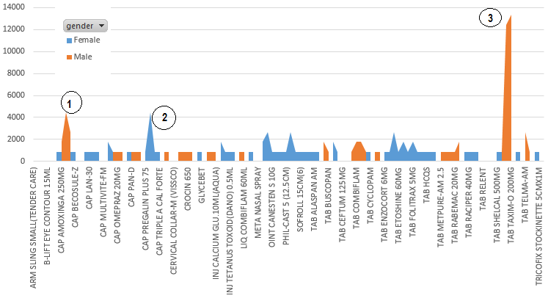
Trend –Most consumed Drugs
Higher Antibiotics consumption in MALE – 1, 3
Pregalin (pain killer) most consumed in FEMALE - 2
Finally, TAXIMO 200 mg is most consumed drug - 4
across genders and Age

Slide 5
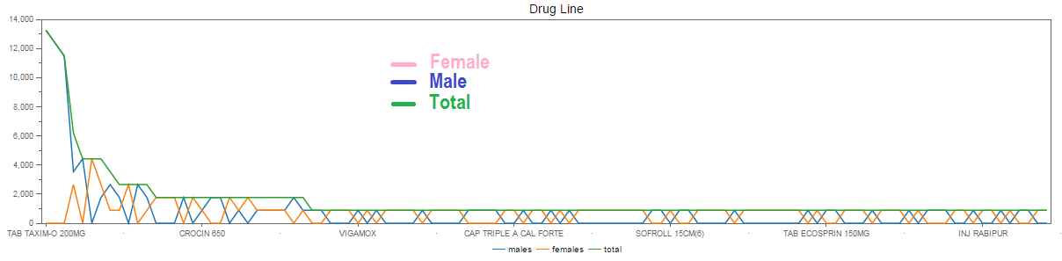
Opposite yet pretty constant ☺ Except TAXIMO

